Slide 1
Human Activity Recognition
Presentation by:
Ashutosh Bhawsar - 29
Ninad Kapadnis - 30
Devashish Katoriya - 31
Bhushan Shilawat - 32

Slide 2
HAR
Human Activity Recognition.
Active research areas in computer vision.
Applications like security surveillance, healthcare and human computer interaction.

Slide 3
HAR
There are six activities in the dataset :
1. Walking
2. Walking Upstairs
3. Walking Downstairs
4. Sitting
5. Standing
6. Laying

Slide 4
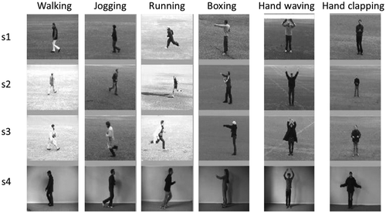
HAR

Slide 5
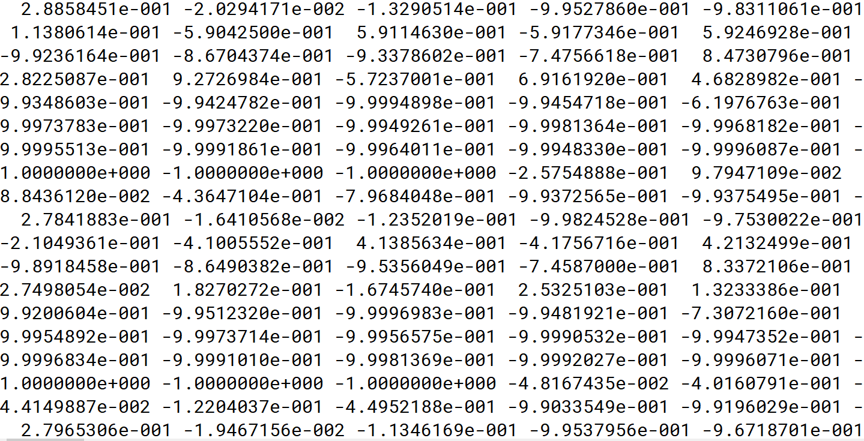
The Dataset
Accelerometer and Gyroscope
No. of Tuples = 8192
No. of Attributes = 561
Therefore, Dimension of Dataset = 8192 x 561
Train to Test Ratio = 7/3

Slide 6
Approach using K-NN
Used for both classification and regression predictive problems.
Widely used in classification problems in the industry.
To evaluate any technique we generally look at 3 important aspects:
1. Ease to interpret output
2. Calculation time
3. Predictive Power

Slide 7
Applications
Human-computer interaction
User interface design
Robot learning
Surveillance systems

Slide 8
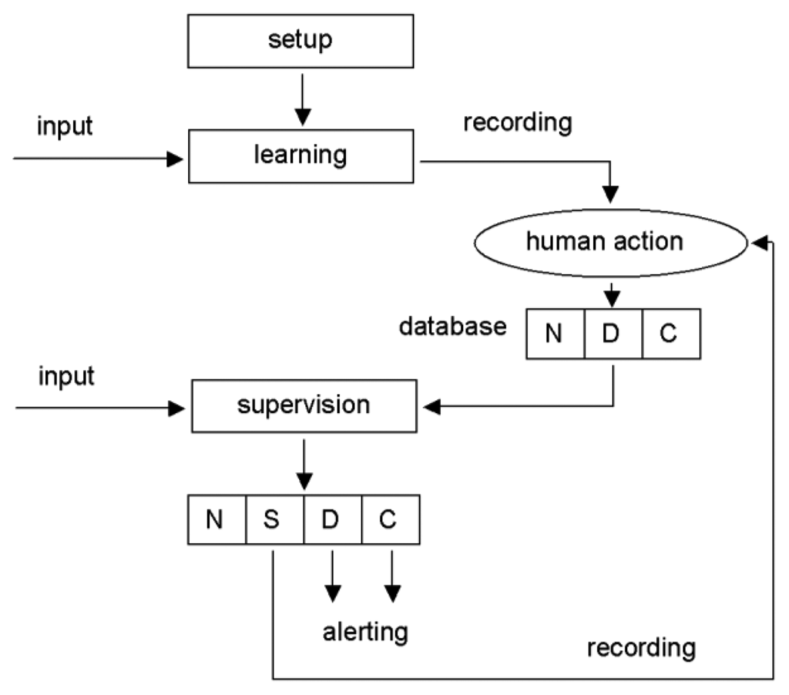
Block Diagram

Slide 9
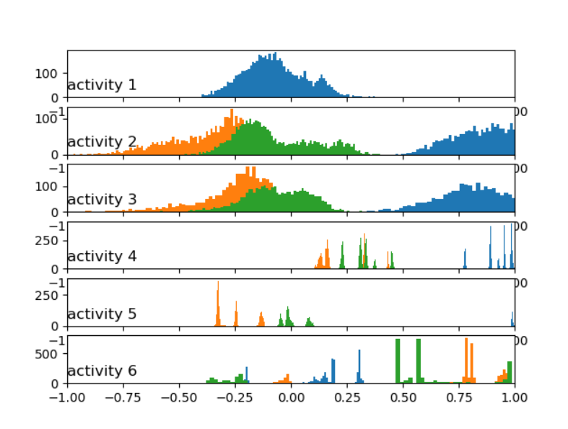
Output

Slide 10
Thank You

